Slide 1

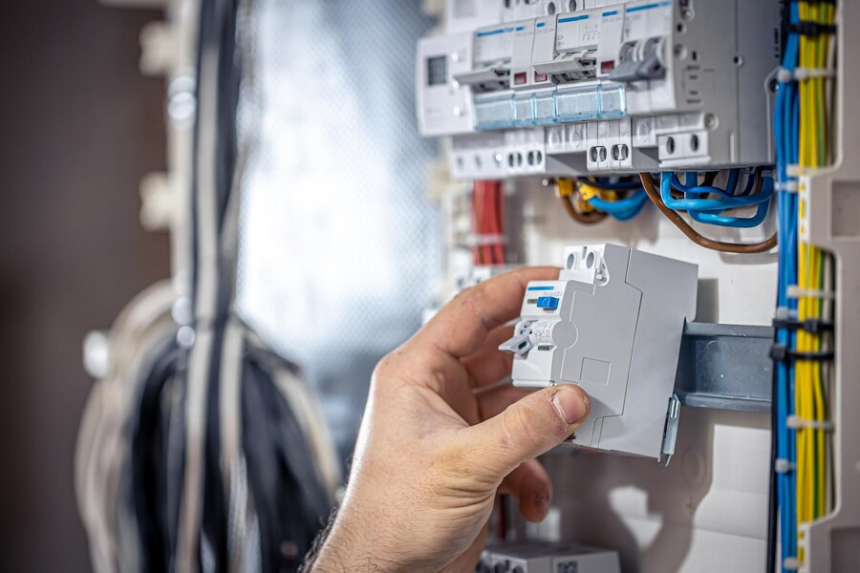

TEAM : TVA
CURENTLY
St . Joseph’s college of engineering and technology, palai

Slide 2
Content
01
Abstract
02
OBJECTIVES
03
UI DESIGN
04
HARDWARE

Slide 3
Our project, "Real-time Energy Monitoring System," utilizes IoT technology to monitor electricity consumption. It features a sensor module that captures real-time data from outlets, wirelessly transmitting it to a server for analysis. A user-friendly mobile app provides insights on current usage, historical data, and trends, with alerts for anomalies and personalized energy-saving tips.
ABSTRACT

Slide 4



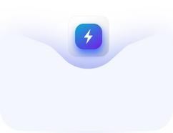


Objectives
Realtime Monitoring
Implement a system capable of continuously monitoring household energy consumption in real-time
Data Analysis
Provide users with insightful analysis of energy usage patterns, including current consumption, power usage, and kWh consumption over specific time intervals
CURENTLY
User Accessibility
To develop a user-friendly mobile application interface allowing secure access to energy consumption data, promoting user engagement and awareness.
Bill Calculation
Determine the total energy cost by multiplying the energy consumption (in kWh) by the unit price of electricity, accounting for any fixed charges.

Slide 5


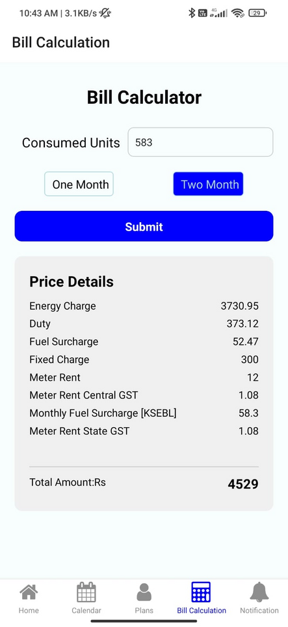
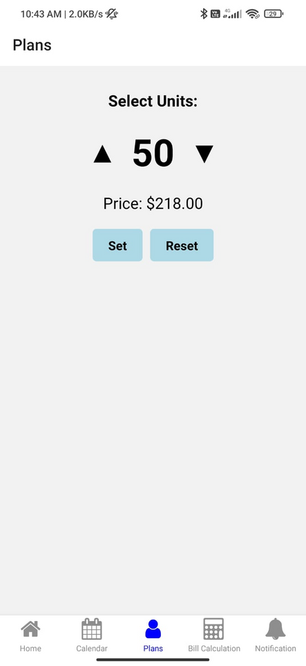
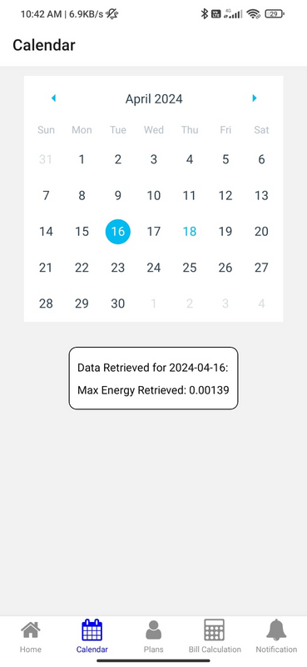
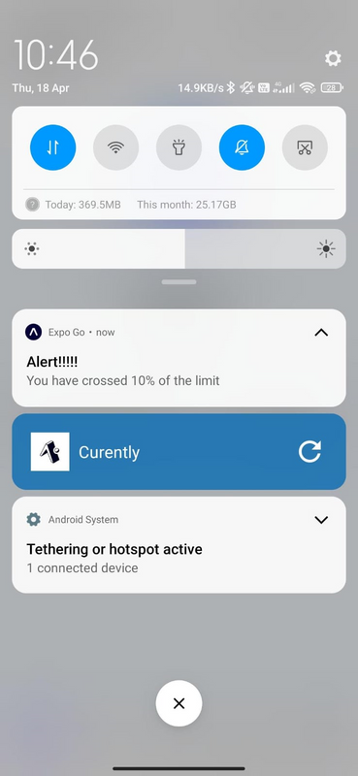
UI DESIGN
BILL CALCULATOR
PLANS
CALENDER
ALERT

Slide 6

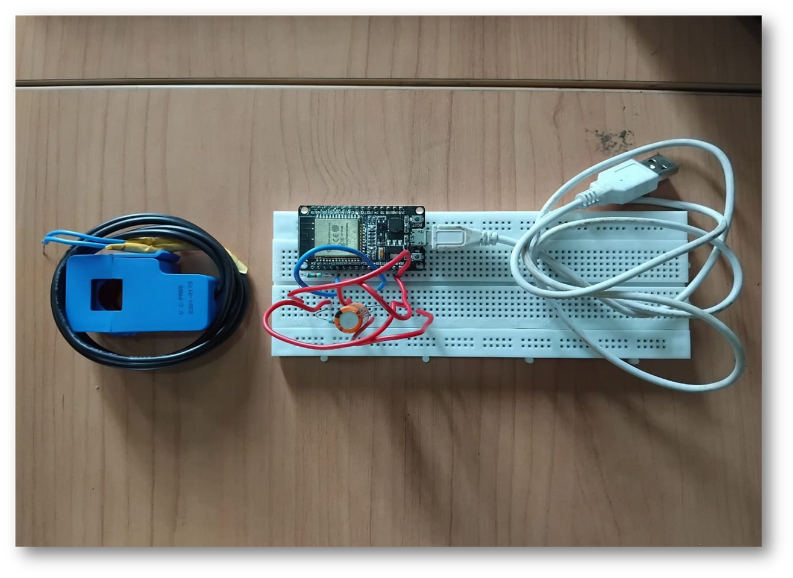
HARDWARE

Slide 7
THANK YOU

